Slide 1

FPGA Design flow using PlanAhead
Mahmoud Sadollahi
Vahid Behravan

Slide 2
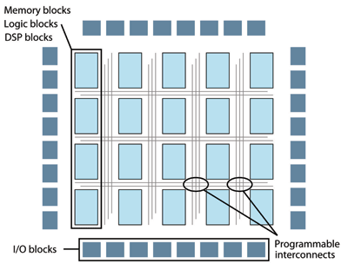
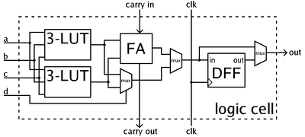
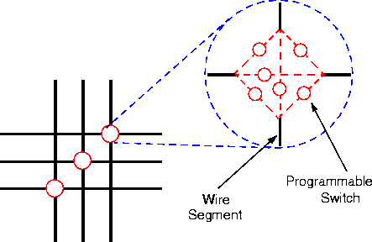
What is FPGA ?
A field-programmable gate array (FPGA) is an integrated circuit designed to be configured by a customer or a designer after manufacturing
7/6/2013
2

Slide 3
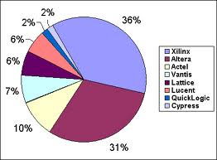
FPGA manufacturers
Xilinx and Altera two major FPGA manufacturers
2010 market share: (reference : sourcetech411.com)
2012 market share: Xilinx 47% , Altera 41%
7/6/2013
3

Slide 4
FPGA programming tools
Xilinx : ISE , PlanAhead , …
Altera : Quartus II
7/6/2013
4

Slide 5
Xilinx FPGA families
CPLD, SPARTAN, VIRTEX, KINTEX, ARTIX, …
FPGA Comparison Table
Features | Artix-7 | Kintex-7 | Virtex-7 | Spartan-6 | Virtex-6
Logic Cells | 215,000 | 480,000 | 2,000,000 | 150,000 | 760,000
BlockRAM | 13Mb | 34Mb | 68Mb | 4.8Mb | 38Mb
DSP Slices | 740 | 1,920 | 3,600 | 180 | 2,016
DSP Performance (symmetric FIR) | 930GMACs | 2,845GMACs | 5,335GMACs | 140GMACs | 2,419GMACs
Transceiver Count | 16 | 32 | 96 | 8 | 72
Transceiver Speed | 6.6Gb/s | 12.5Gb/s | 28.05Gb/s | 3.2Gb/s | 11.18Gb/s
Total Transceiver Bandwidth (full duplex) | 211Gb/s | 800Gb/s | 2,784Gb/s | 50Gb/s | 536Gb/s
Memory Interface (DDR3) | 1,066Mb/s | 1,866Mb/s | 1,866Mb/s | 800Mb/s | 1,066Mb/s
PCI Express® Interface | x4 Gen2 | x8 Gen2 | x8 Gen3 | x1 Gen1 | x8 Gen2
Analog Mixed Signal (AMS)/XADC | Yes | Yes | Yes |  | Yes
Configuration AES | Yes | Yes | Yes | Yes | Yes
I/O Pins | 500 | 500 | 1,200 | 576 | 1,200
I/O Voltage | 1.2V, 1.35V, 1.5V, 1.8V, 2.5V, 3.3V | 1.2V, 1.35V, 1.5V, 1.8V, 2.5V, 3.3V | 1.2V, 1.35V, 1.5V, 1.8V, 2.5V, 3.3V | 1.2V, 1.5V, 1.8V, 2.5V, 3.3V | 1.2V, 1.5V, 1.8V, 2.5V
EasyPath Cost Reduction Solution | - | Yes | Yes | - | Yes
7/6/2013
5

Slide 6
Planahead Overview
PlanAhead is a tool for performance improvement of design.
When you use all HDL coding techniques for performance improvement and you don’t achieve the goals, PlanAhead can help.
It is usually useful for design over 150MHz.
Xilinx has a plan to replace ISE by PlanAhead from version 15 of ISE.
7/6/2013
6

Slide 7
Overview (Cont.)
PlanAhead basically can do everything that ISE can do, including synthesis and implementation.
It has a better GUI than ISE and also more suitable for timing analyzing and performance improvement of design.
It includes some features not available in ISE and user can use them to do performance evaluation/improvement more easily.
RTL Developing
RTL Analysis
Create Netlist
Netlist
Analysis
Implementation (PAR)
Floorplanning
Impl.
Analysis
7/6/2013
7

Slide 8
RTL Analysis
analyze the RTL logic hierarchy
RTL schematic
RTL resource estimations
RTL power estimations
run an RTL Design Rule Check (DRC).
7/6/2013
8

Slide 9
Netlist Analysis
Design statistics
Hierarchical viewer
Schematic viewer
Timing report (estimation)
DRC
7/6/2013
9

Slide 10
Implementation Analysis
Design statistics
Hierarchical viewer
Schematic viewer
Timing report and critical path viewer
DRC
Connectivity
Floorplanning
7/6/2013
10

Slide 11
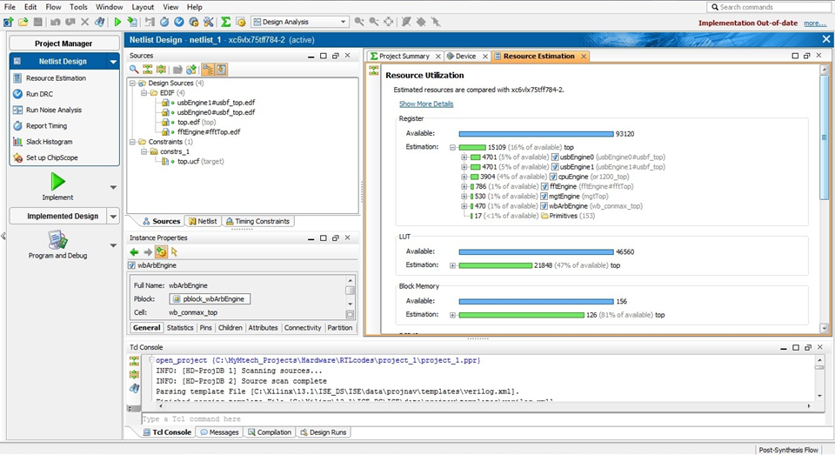
Design statistics
7/6/2013
11

Slide 12
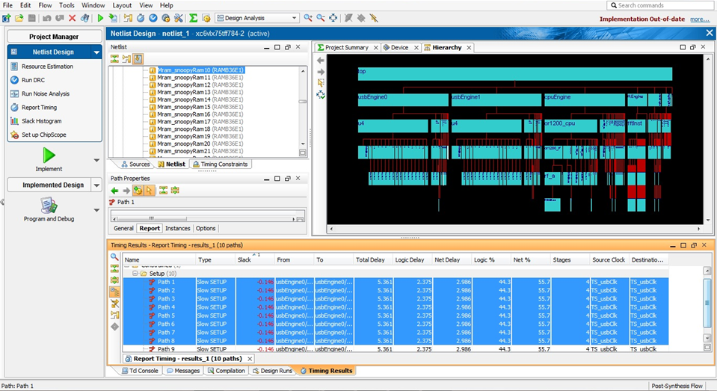
Hierarchical viewer
7/6/2013
12

Slide 13
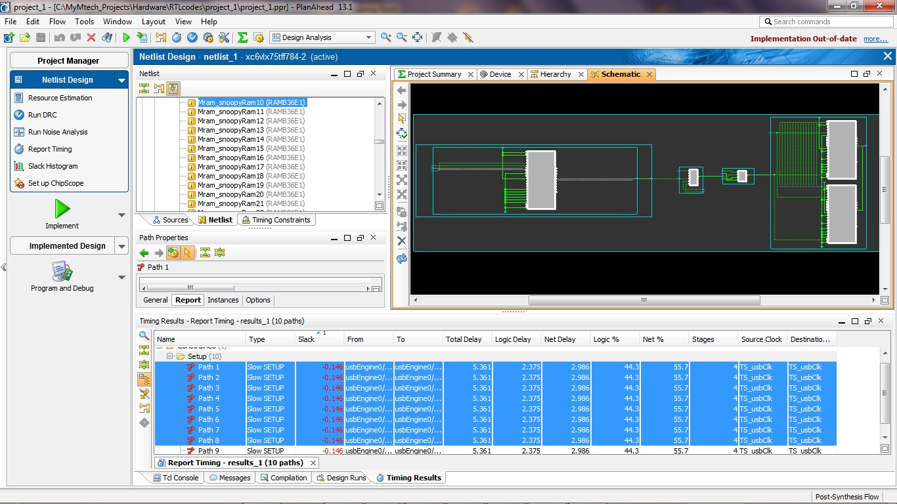
Schematic viewer
7/6/2013
13

Slide 14
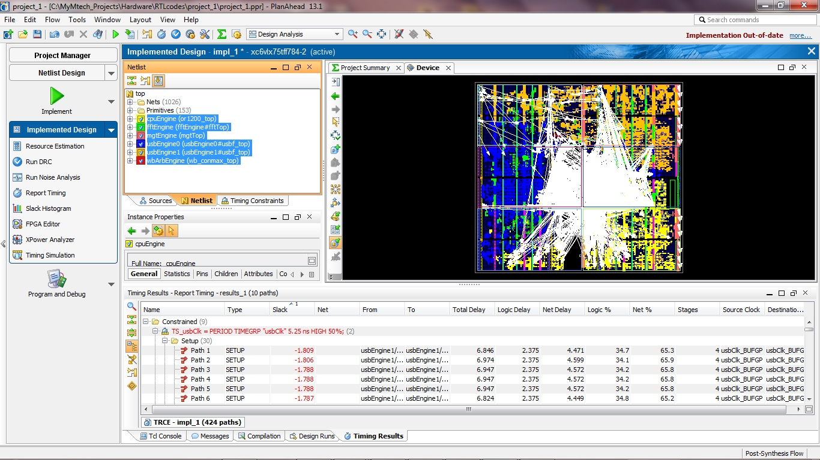
Connectivity
7/6/2013
14

Slide 15
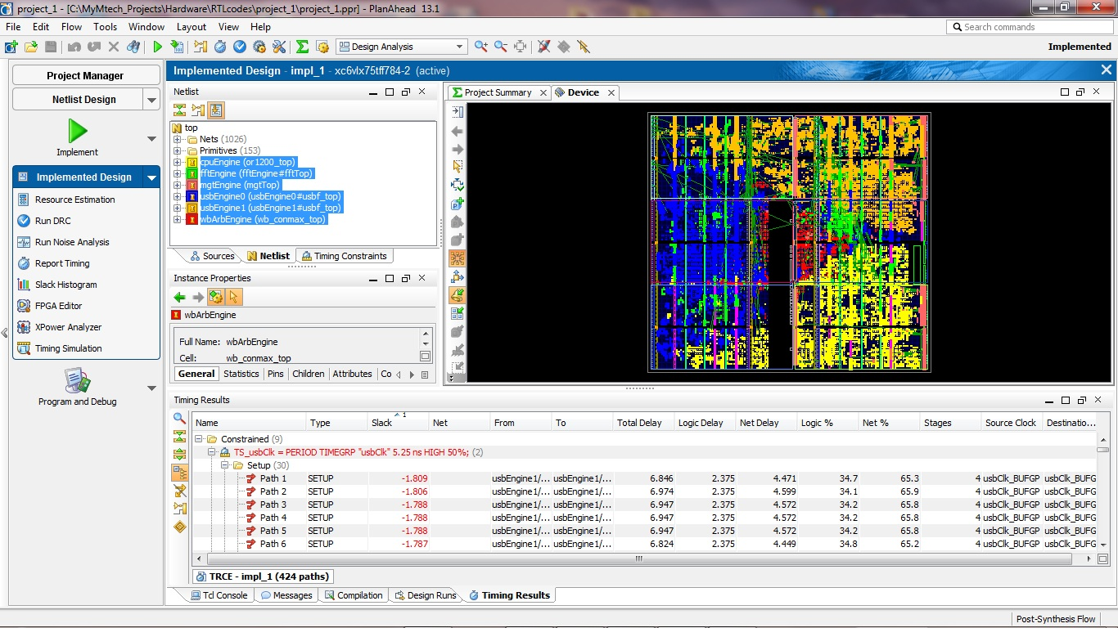
Connectivity (Cont.)
7/6/2013
15

Slide 16
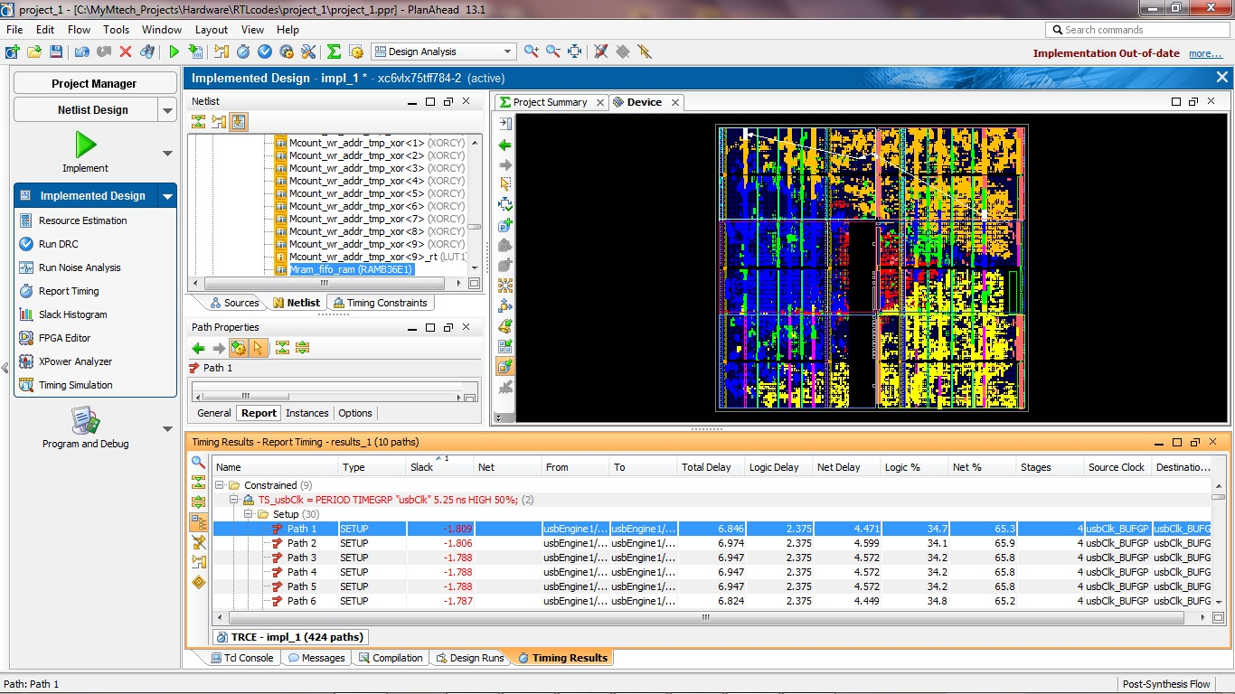
Critical path viewer
7/6/2013
16

Slide 17
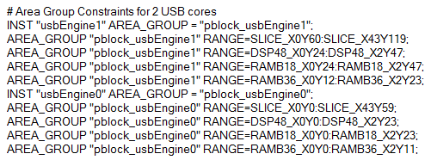
Implementation Analysis
Defining area for each block (module) can be done with adding some lines in UCF file.
7/6/2013
17

Slide 18
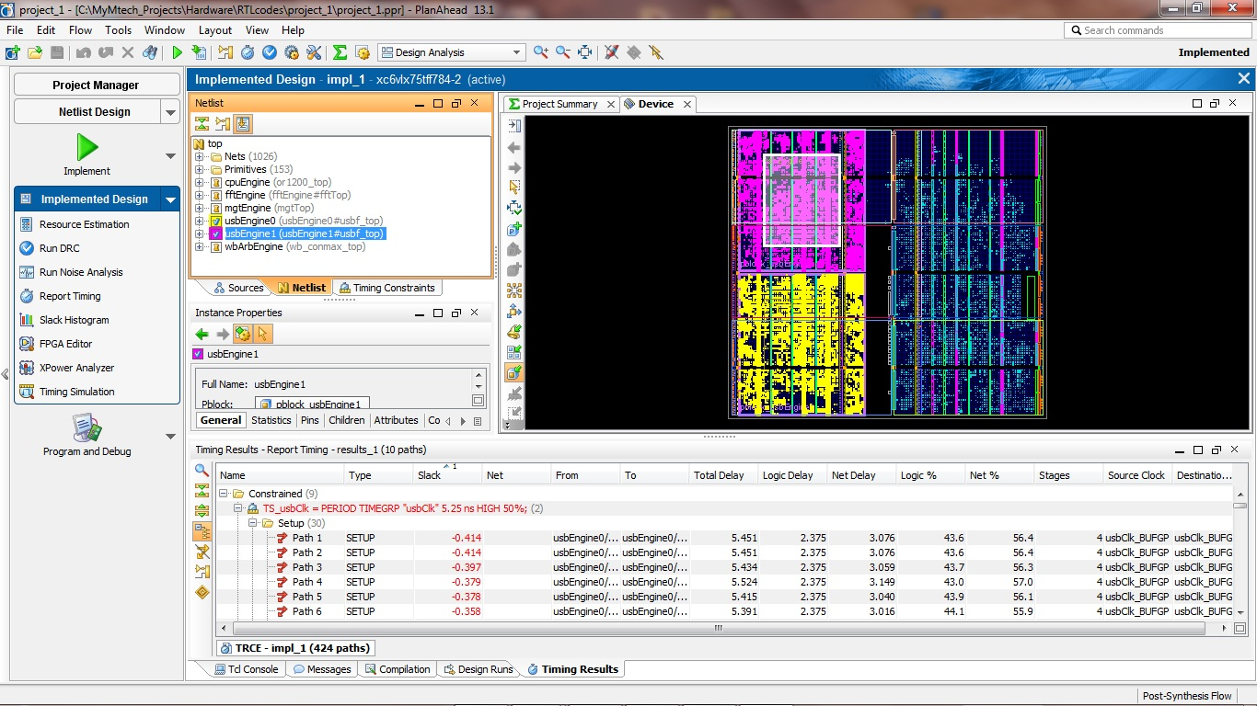
Floorplanning
7/6/2013
18

Slide 19
Summary
When all HDL coding techniques don’t help to achieve desired performance, there is one more way: Floorplanning.
For Floorplanning we need to make a very important decision: which block or blocks are good candidates for floorplanning?: PlanAhead helps designer to make this decision.
Floorplannig is an iterative procedure.
7/6/2013
19

Slide 20
Thank You
7/6/2013
20

